Slide 1
Course Title: OOP 2 Course Code: CSC 2210
Dept. of Computer Science
Faculty of Science and Technology
Topis: Array
Lecturer No: | 2.2 | Week No: | 2 | Semester: | Fall 2022-23
Lecturer: | Nyme Ahmed (nyme.ahmed@aiub.edu)

Slide 2
Array
Introducing Array:
Array is a sequence of elements, all of which are the same type. You can build simple arrays that have one dimension (a list), two dimensions (a table), three dimensions (a cube), and so on.
Every element in the array contains a value.
Arrays are zero-indexed, that is, the first item in the array is element 0.
The size of an array is the total number of elements that it can contain.

Slide 3
Array
Introducing Array:
An array has the following properties:
An array can be Single-Dimensional, Multidimensional or Jagged.
The number of dimensions and the length of each dimension are established when the array instance is created. These values can’t be changed during the lifetime of the instance.
The default value of numeric array elements are set to zero, and reference elements are set to null.

Slide 4
Array
Declaring Array:
When you declare an array, you specify the type of data that it contains and a name for the array. When you use the new keyword, array is created. At this point, you should specify the size of the array.
Syntax:
dataType[] arrayName = new dataType [size];
Example:
int[] arrayName = new int[10];

Slide 5
Array
Declaring Array:
You can also choose to create an array and initialize it with values at the same time as in the following example that declares an integer array and assigns values to it. The compiler know how large to make the array by the number of values in the curly braces:
int[] arrayName = {1,2,3,4,5,6,7,8};
or
int[] arrayName = new int[] {1,2,3,4,5,6,7,8};

Slide 6
Array
Array as objects:
In C#, arrays are actually objects.
Array is the abstract base type of all array types. We can use the properties and other class members, that Array has.
int[] number = { 1, 2, 3, 4, 5 };
int length = number.Length;
Console.WriteLine("Length of the array is {0}",length);
Console.WriteLine(“It is {0} dimension",number.Rank);

Slide 7
Array
Accessing data in an array:
You can access data in an array in several ways, such as by specifying the index of a specific element that you require or by iterating through the entire array and returning each element in sequence.
int[] oldNumbers = { 1, 2, 3, 4, 5 };
int number = oldNumbers[2];
for (int i = 0; i < oldNumbers.Length; i++){
int number = oldNumbers[i];
...}

Slide 8
Array
Single-Dimension array (1D Array):
You can declare a single dimension array of five integers as shown in the following example.
int[] arrayName = new int[5];
An array that stores string elements can be declared in the same way. Example-
string[] arrayName = new string[6];

Slide 9
Array
Multidimensional array:
An array can have more than one dimension. You can specify up to 32 dimensions, but you will rarely need more than three.
You declare a multidimensional array variable just as you declare a single-dimensional array, but you separate the dimensions by using commas.
For example, the following declaration creates a 2D array of 4 rows and 2 columns.
int[,] arrayName = new int [4,2];

Slide 10
Array
Multidimensional array:
We can also initialize the array without specifying the numbers of row and column.
int[,] arrayName = {{1,2},{3,4},{5,6},{7,8}}
In order to access elements in a multidimensional array, you must include all indices such as-
int value1 = arrayName[0,0];
int value2 = arrayName[0,1];

Slide 11
Array
Jagged array:
A jagged array is an array whose elements are arrays. The elements of jagged array can be of different dimensions and sizes. A jagged array is sometimes called an ‘array of arrays’.
Jagged arrays are useful for modeling sparse data structures where you might not always want to allocate memory for every item if it is not going to be used.
The following is the declaration of the jagged array that has three elements and each element is 1D array of integers.
int [][] jaggedArray = new int[3][];

Slide 12
Array
Jagged array:
Before using jagged array, its elements must be initialized. We can initialize the elements like this:
jaggedArray[0] = new int[5];
jaggedArray[1] = new int[4];
jaggedArray[2] = new int[2];
It is also possible to use initializers to fill the array elements with values.
jaggedArray[0] = new int[] {1,2,3,4,5};
jaggedArray[1] = new int[]{2,4,6,8};
jaggedArray[2] = new int[]{5,10};

Slide 13
Array
Jagged array:
We can also initialize the array upon declaring like this:
int[][] jaggedArray2 = new int[][]
{
new int[] {1,3,5,7,9},
new int[] {2,4,6,8},
new int[] {0,5,10}
};

Slide 14
Array
Jagged array:
We can access individual array elements in jagged array like these example:
//Assign 77 to the second element of first array
jaggedArray[0][1] = 77;
//Assign 84 to the second element of second array
jaggedArray[1][1] = 84

Slide 15
Array
Jagged array:
The following is a declaration and initialization of a three elements jagged array and each element is 2D array of integers.
int[][,] jaggedArray2 = new int[3][,]
{
new int[,]{ {1,3},{5,7} },
new int[,]{ {0,2},{4,6},{7,8} },
new int[,]{ {1,2},{2,3},{3,4} }
};

Slide 16
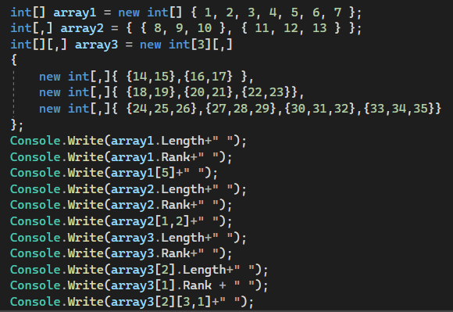
Array
What will be the output??
Output:
7 1 6 6 2 13 3 1 12 2 34

Slide 17
Array
Using foreach with arrays:
The foreach statement processes elements in the order returned by the array, which is usually from the 0th element to the last. Example-
int[] number = { 1, 2, 3, 4, 5, 6 };
foreach(int i in number)
{
Console.Write(i + " ");
}

Slide 18
Array
Passing arrays as arguments:
Array can be passed as arguments to method parameters.
Arrays are reference type, the method can change the value of the elements.
int[] theArray = {1,3,5,7};
PrintArray(theArray);
void PrintArray(int[] arr)
{
//method code
}

Slide 19
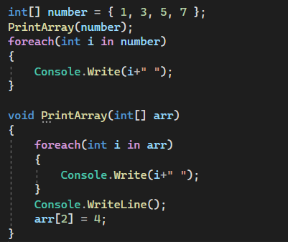
Array
What will be the output??
Output:
1 3 5 7
1 3 4 7

